Slide 1
Selecting the best location for an Italian Restaurant

Slide 2
Italian Restaurants in New York
- New York as a city has 50,153 eating places where the estimated revenue is 51.6 billion.
New York restaurants created 865,800 jobs and they count for 9% for the employment in the state.
According to Quora.com, there are 993 Italian restaurants in New York.
A big Italian restaurant could generate between 200-300k dollar per month
Goal: Find the best neighborhood for an Italian restaurant

Slide 3
Best Location Criteria
A neighborhood with no italian restaurants
A neighborhood where the number of restaurants is less than 5
A neighborhood which is accessible through metro/bus

Slide 4
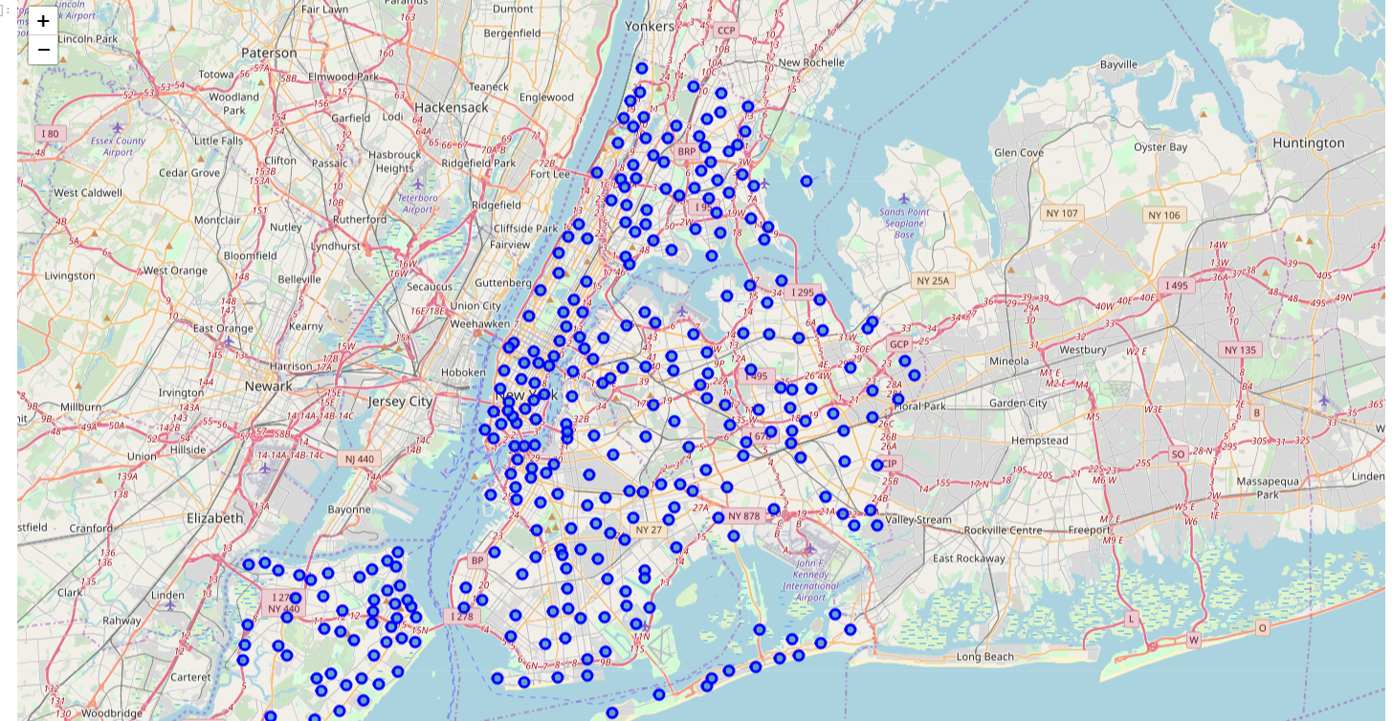
New York has 306 neighborhoods

Slide 5
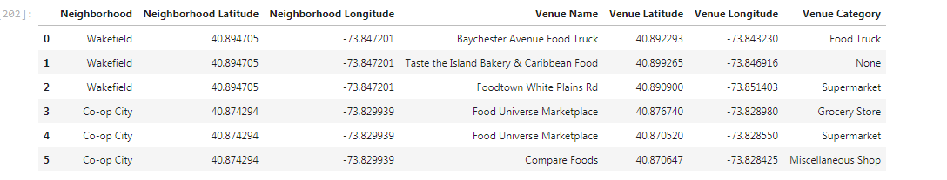
Using Forsquare Api to determine the restaurants in each neighborhood

Slide 6
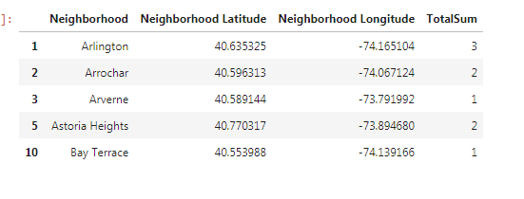
Selecting only neighborhoods with required criteria

Slide 7
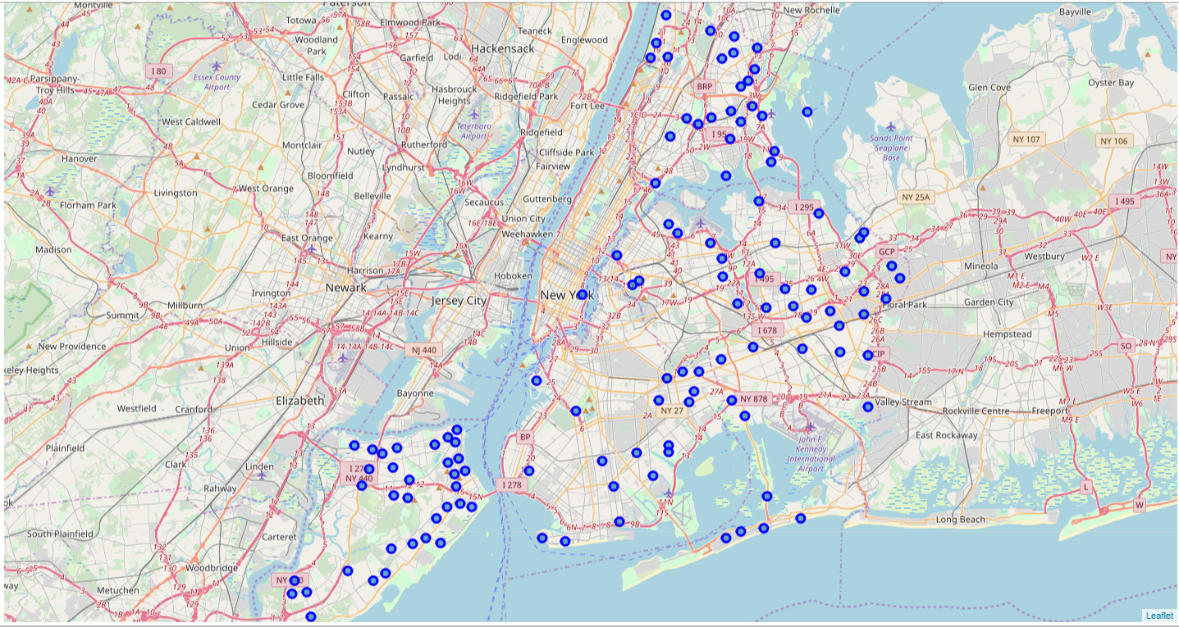
Map View of the results

Slide 8
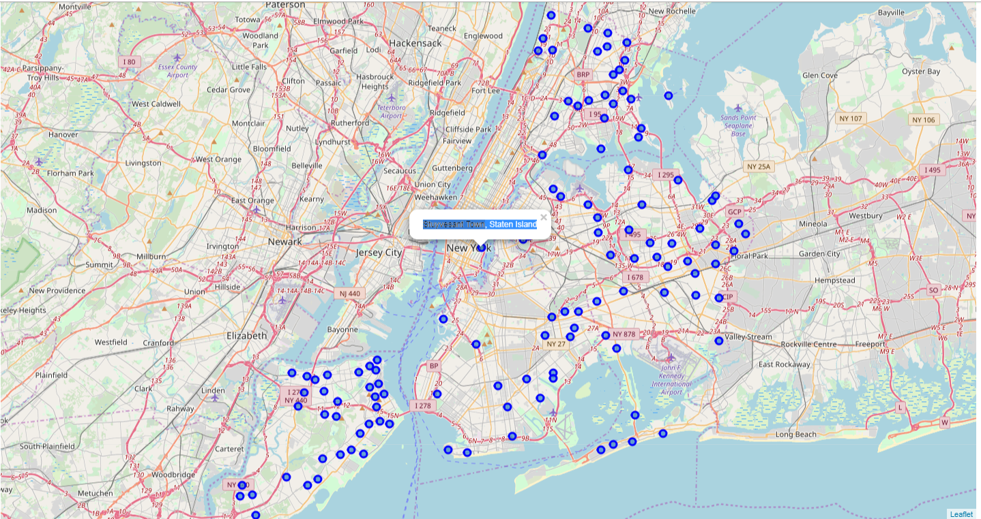
Best Neighborhood in manhatten is :Stuyvesant Town, Staten Island

